Slide 1


Git Extended Commands

Slide 2

Agenda
Recap git basics: git add, git commit, git status, git show
Recap git basics: git log, git pull, git push
Git branch, git checkout and some options.
Creating a new branch locally and publishing in the remote
Renaming a branch that hasn’t been pushed
Renaming a branch that has been pushed (exist in local and remote)
Deleting Branches
Git reflog
Git log with graph
Amending a commit
Undoing a commit with git revert / git reset

Slide 3
Recap: git Basics
Add files/folders to the staged area:
git add <file_name || folder || .>
Commit staged changes:
git commit -m “<descriptive_message>”
Checking for modifications. Showing what is going to be committed, what is staged/could be added to the staged area:
git status
Showing remote’s information:
git remote show <remote_name>

Slide 4
Recap: git Basics
Showing general status (latest commit, differences between files)
git show
Showing the list of commits with their hashes and messages:
git log
Fetching and merging changes (pulling):
git pull <remote> <branch>
Publishing changes to another branch:
git push <remote> <branch>

Slide 5
Creating a new branch and switching
To create a new branch you need to use the command git branch
git branch <branch_name>
Then you will need to switch to it using git checkout. Git checkout can switch between branches and commits.
git checkout <branch_name>
There is a command that sums up the creation and switching. It is:
git checkout -b <branch_name>

Slide 6
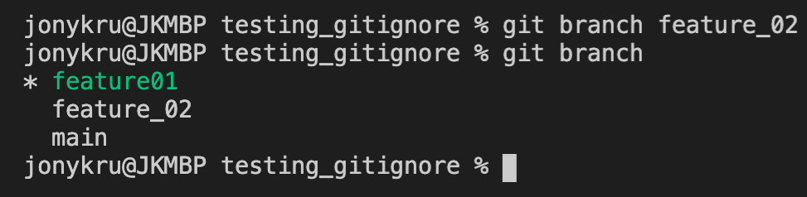
Creating a new branch and switching
To create a new branch you need to use the command git branch + a name
git branch <branch_name>
To create a new branch you need to use the command git branch
git branch

Slide 7
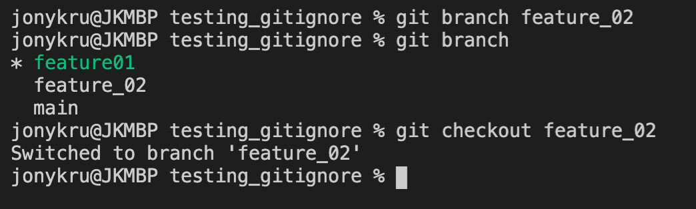
Creating a new branch and switching
To switch to it we need to use the command git checkout + branch name
git checkout <branch_name>

Slide 8
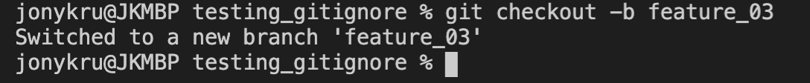
Creating a new branch and switching
We can do the previous 2 commands at once by running:
git checkout -b <branch_name>

Slide 9
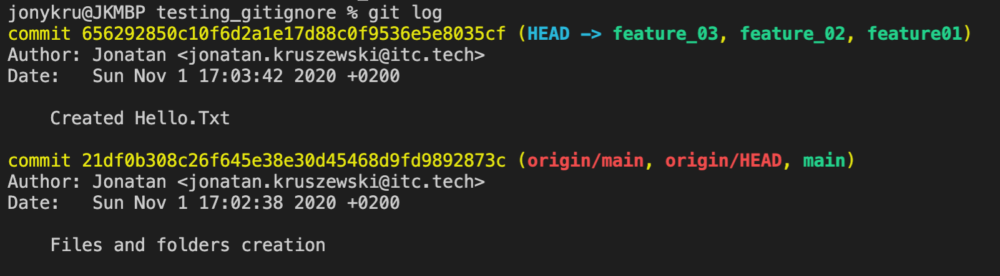
Creating a new branch and switching
When you create a new branch, git automatically sets the HEAD of that branch at where your previous branch was. In this case, we branched out from feature_02, so the HEAD is at its same place:

Slide 10
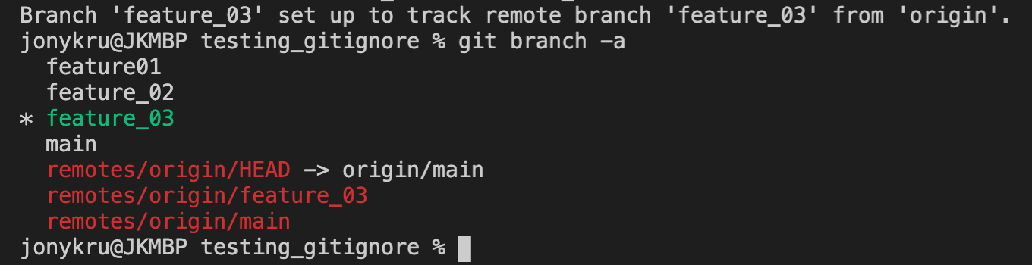
Publishing the new branch to the remote
To push your branch to the remote you need to run:
git push -u <remote_name> <give_a_name_to_branch_in_remote>
Which will probably be the same name locally. The -u means --set-upstream, which means that from the next time you can pull/push from that branch just by using git pull or git push without specifying the full address.
git push -u origin feature_03

Slide 11
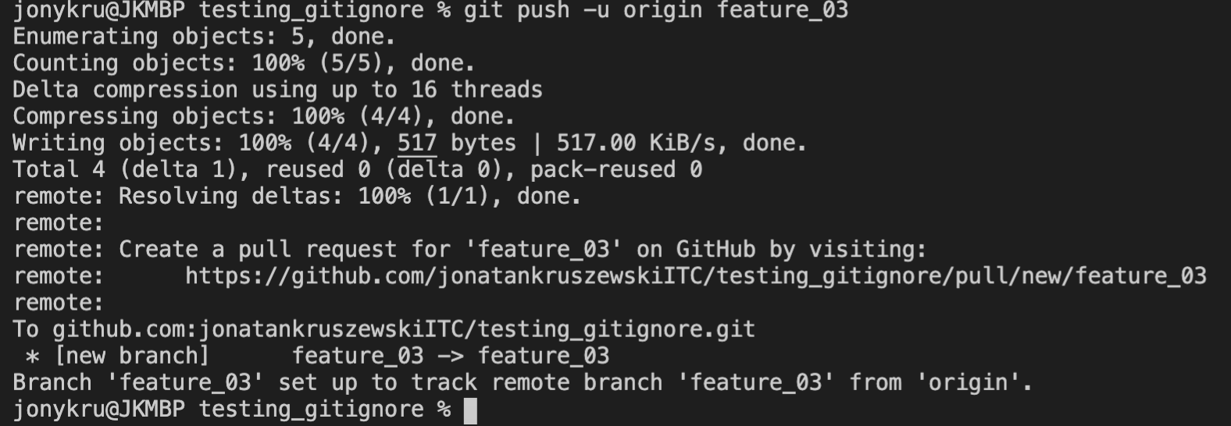
Publishing the new branch to the remote
After pushing, we should see a message like the following:

Slide 12
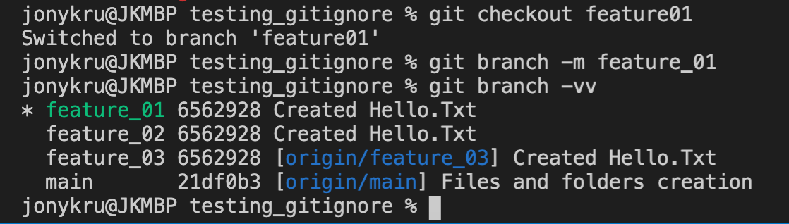
Renaming a local branch
As we can notice feature01 doesn’t follow the project convention. Let’s rename it. For that, let’s switch to that branch so we can rename it:
git checkout feature01
Now let’s rename it:
git branch -m <new_name>

Slide 13
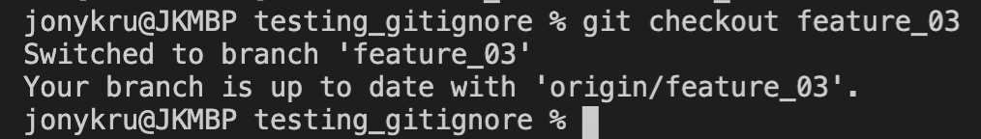
Renaming a branch on local and remote
That was easy because feature01 wasn’t tracked on the remote. Let’s do the same with feature_03 to feature_04, both local and in remote.
git checkout feature03
Let’s repeat the process. Renaming it locally, and then push it:
git branch -m feature_04
git push -u origin feature_04

Slide 14
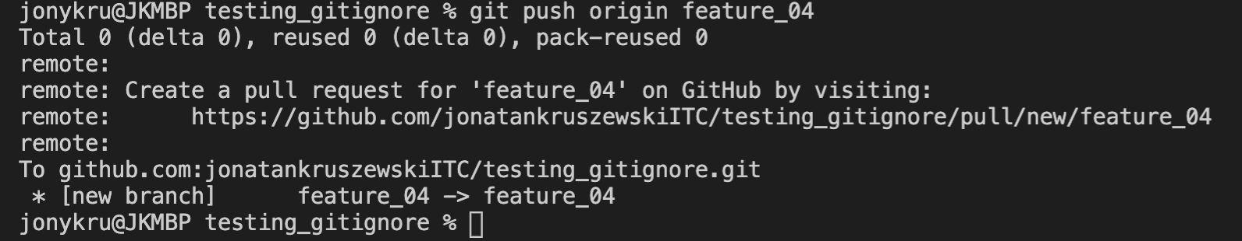
Renaming a branch on local and remote
So far, we have pushed a new branch to the master (origin/feature_04)
Forgot the -u.
No -u? No upstream, so I had to manually set the upstream branch afterwards😑
It got fixed by running:
git branch feature_04 -u origin/feature_04
Let’s delete the feature_03 branch in the remote:
git push origin --delete feature_03
Beware! This can’t be undone easily.

Slide 15
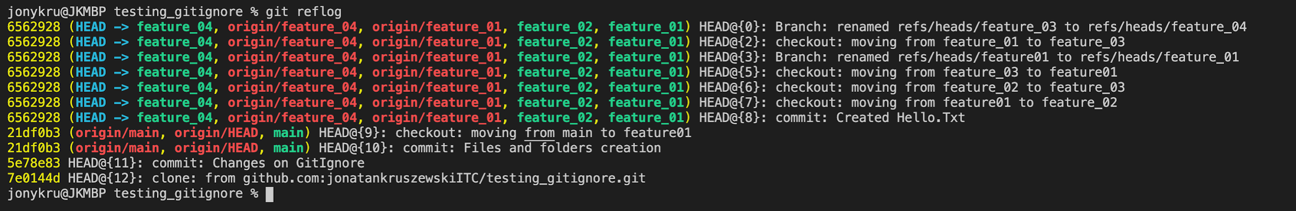
Inspecting what has been done
We can see all the history of what has been done in the repository by running:
git reflog
The number next to HEAD@{<num>} indicates number of positions backwards. We can see that the HEAD@{1} has been deleted.

Slide 16
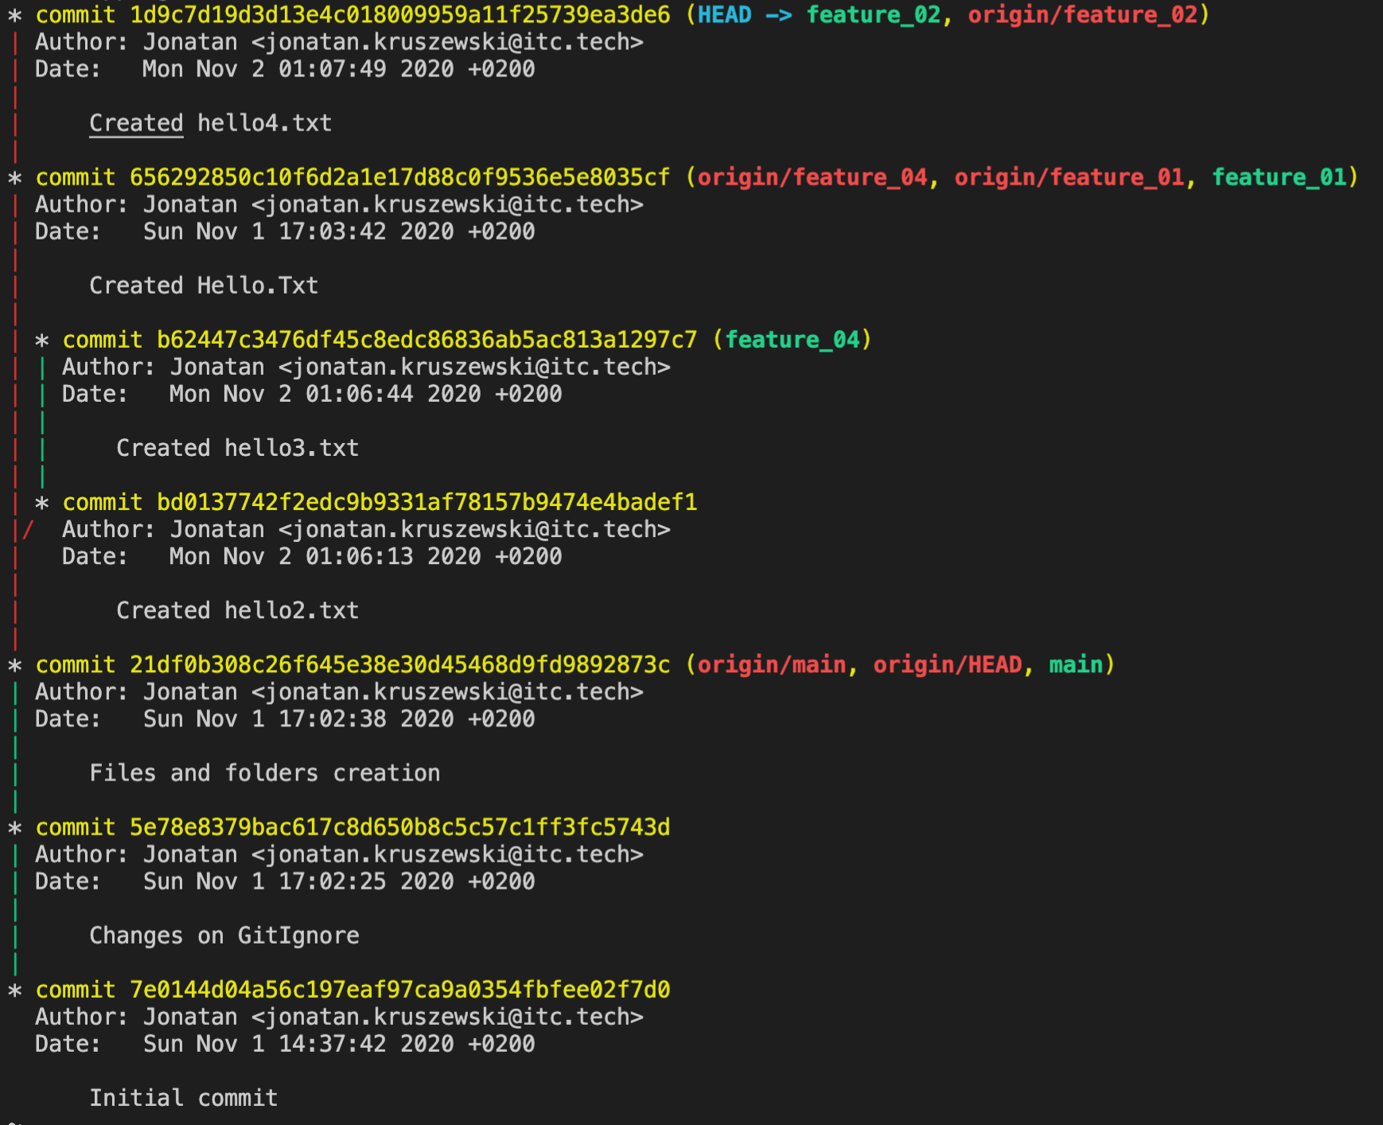
Git log with graph
You can pass some options to draw a nice log tree:
git log --graph --decorate --all

Slide 17
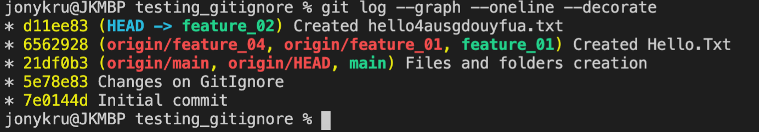
Fixing the last commit
Let’s say you have the following situation:
You created a commit, and you had a typo in the message:
You can fix that by amending the commit. Amend, it is an option from git commit that allows you to edit the previous commit. You can:
Change the message of the commit
Use it to fix the commit itself: add files, remove, fix lines.

Slide 18
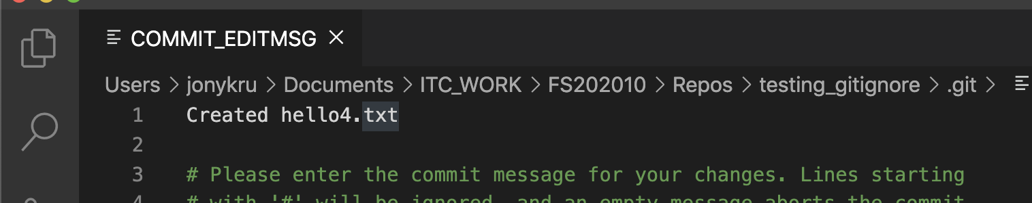
Fixing the last commit
Let’s change only the message for now:
git commit --amend
A window with the commit message will open, and we can fix it and save. Once saved we can check the changes with git log. We can use some options with it:
git log --graph --oneline --decorate

Slide 19
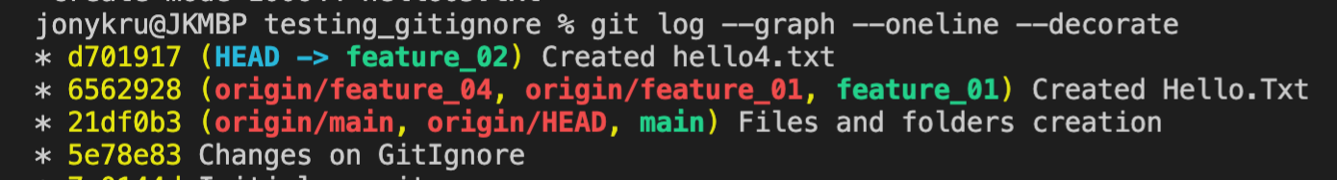
Fixing the last commit
As you can see, the SHAS of the commit changed. Why? Because git commit amend will OVERWRITE the old commit with a new one.
If the commit hasn’t been published, no problem. But if the commit has been published to a public branch, it will create problems for other developers.

Slide 20
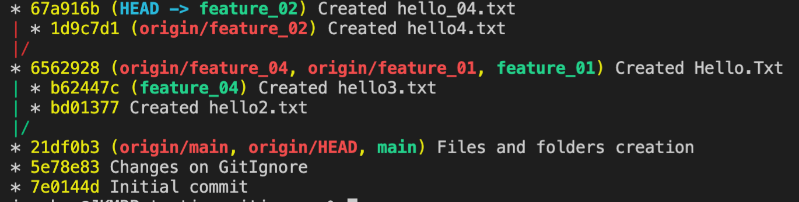
Fixing the last commit
LESSONS on git commit --amend:
Don’t amend a commit on public branches.
Only amend commits that they are going to be pushed to a branch that only you are working at or hadn’t been published yet.
You can amend commits as many times as you want if they hadn’t been pushed yet

Slide 21
Fixing the last commit
If you wanted to add more changes to the latest commit:
Perform those changes, and stage them:
git add <the_files>
git commit --amend --no-edit
The --no-edit is for keeping the commit message as it was.
This will add the new staged changes to the previous commit.
Remember that the fixed commit will be a NEW commit.

Slide 22
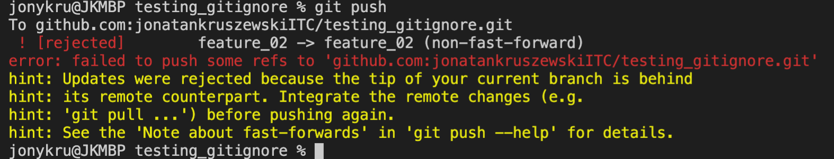
Fixing the last commit
Trying to push a commit that has been published in amended will get you the following:
Which means, we need to pull, solve conflicts, merge, and then push.
Conclusion: if the commit that you want to modify has already been published using git commit --amend might not be the best approach.

Slide 23
Undoing a commit
Git revert, will be a non-destructive way to fix it. Will create an opposite commit of the one desired to erase, leaving a clear tree of what happened.
When is it useful?:
When you want to keep the history of what happened.
When the commit is not the last one.
When the changes has been published in a public branch.
Git reset, will move the pointer of the branch to another commit, making that commit the new tip of the branch. It is restructuring your commit history, rather than modifying a commit. It detaches the undesired commit from the branch, but doesn’t delete the commit (can be seen with git reflog). Afterwards you detach that commit, you can keep working and add new commits to that history.
When is it useful?:
When the commit/s you want to remove are at the end of the tree
When you want to detach a commit(s) and create new ones.

Slide 24
Undoing a commit: git revert
Git revert will create a commit that is exactly the opposite of the commit(s) provided. It creates a new commit that effectively cancels the requested ones. For example: if we created a file and committed it, git revert will create a new commit that deletes that file.
How it works: git revert <from_commit>..<to_commit>
Note that the double dot separates one commit from the otter.
You can also pass a commit ID or how many positions from HEAD.
Some warnings:
Working tree must be clean: no staged files. (check it with git status)
If you revert a merge commit, you need to specify to which parent revert, since git can’t identify which one of the ancestors’ history line should be followed.

Slide 25
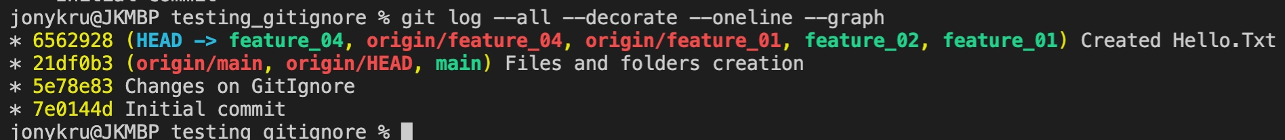
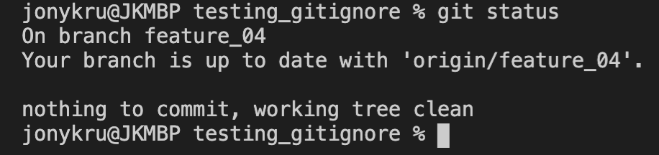
Undoing a commit: git revert
Given the following tree:
Let’s revert the ‘Created hello.txt’ (6562928) commit in the feauture_04 branch.
First we check for a clean tree:
git status

Slide 26
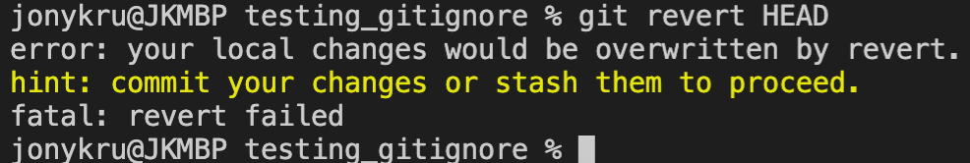
Undoing a commit: git revert
If the working tree wasn’t clean, meaning there were staged files (ready to be committed) we will see this error:
So we either need to commit them, or stash those changes.
git stash === store them, put them on the side, but don’t commit them and leave the working tree clean.
git stash pop === Retrieve back those changes.

Slide 27

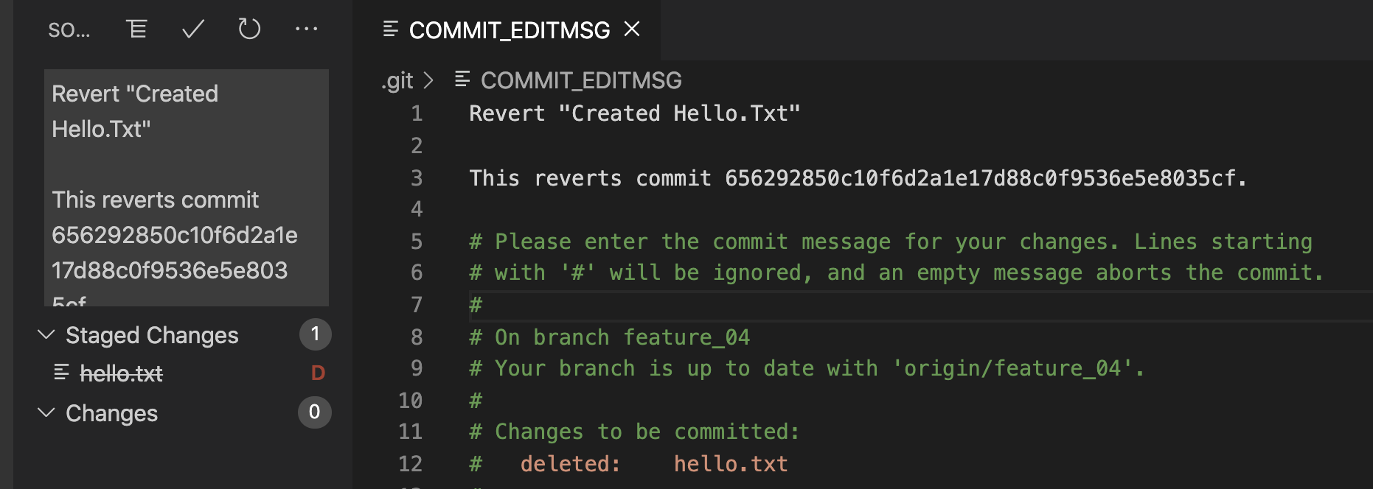
Undoing a commit: git revert
Let’s revert only the last commit:
git revert HEAD
It will open a text editor just to modify the commit message.
🤷
Edit it to your preference, and close.

Slide 28
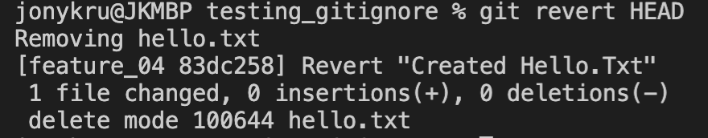
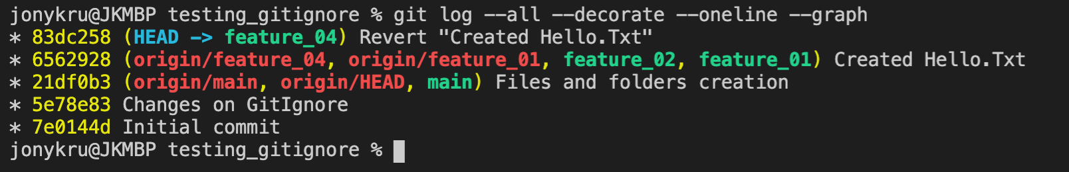
Undoing a commit: git revert
We should see:
We have reverted that commit by creating a new one:

Slide 29
Undoing a commit: git revert
We should see:
We have reverted that commit by creating a new one:

Slide 30
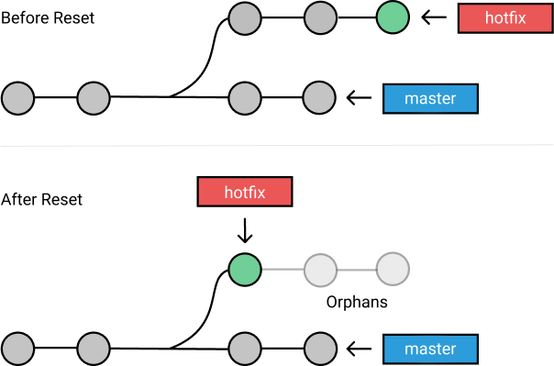
Undoing a commit: git reset
We have created a new commit that reverts the previous one.
Let’s say that we don’t want to show that in history. We want to take out that (or those commits) without leaving a blueprint in the history. Here, we are not actually ‘undoing it’ but detaching that or those commits from the tree, and pointing as HEAD another commit.
The commits in hotfix weren’t deleted, they just are detached from the history.
git reset moves the HEAD to another commit. We can use it to detach unwanted commits, and keep on working.

Slide 31
Detaching a commit: git reset
As we said, let’s detach the unwanted commit’s in our project.
For that, we need to use git reset <target_commit>
Some options:
git reset --soft: will move the head to the specific commit, but keep the staged changes ready to keep on working, and the modified files too.
git reset --mixed: will move the head to the specific commit AND will unstage all the staged changes, moving all of them back to the working area.
git reset --hard: will move the head to the specific commit AND discard staged changes, losing them.

Slide 32
Detaching a commit: git reset
To undo the latest commit we need to do:
git reset HEAD~1
By default it will use the option --mixed.
You can change that option by calling any other one (soft/hard/mixed):
git reset --hard HEAD~1
You can also specify another number of commits, a commit ID, etc.

Slide 33
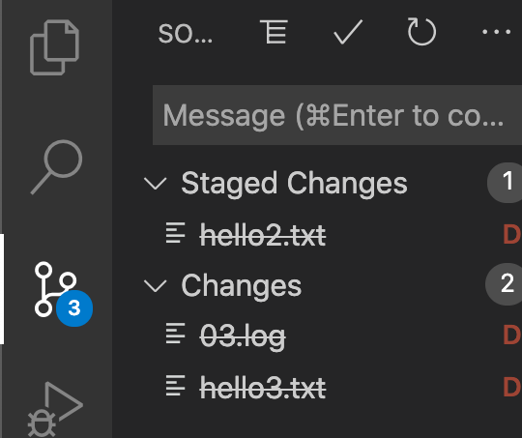
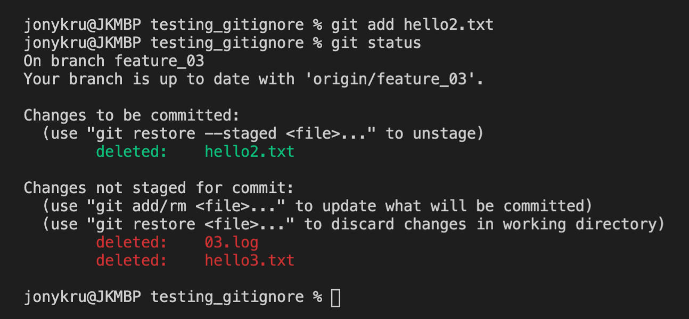
Detaching a commit: git reset
Before we start:
We can see both the staged and unstaged changes in the Version control from VSC or running git status
Let’s see what happens with each option of git reset (hard, mix, soft)

Slide 34
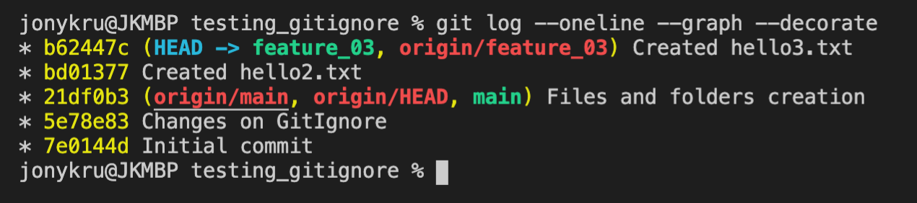
Detaching a commit: git reset
Let’s see how is the tree:
We are going to do a reset to the commit bd01377 “Created Hello2.txt”

Slide 35
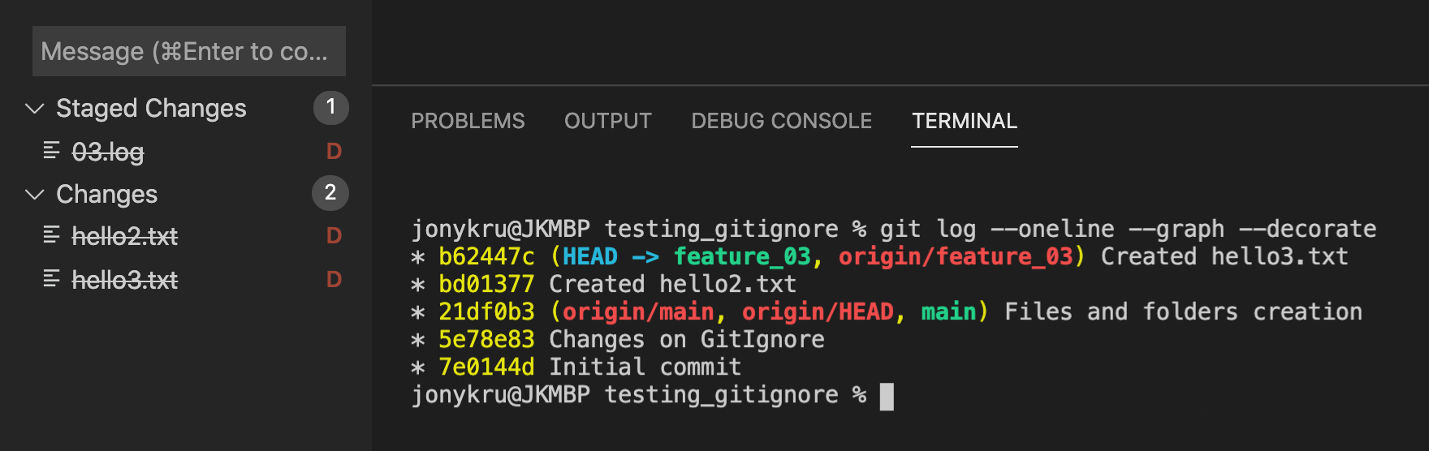
Detaching a commit: git reset --soft
Before

Slide 36
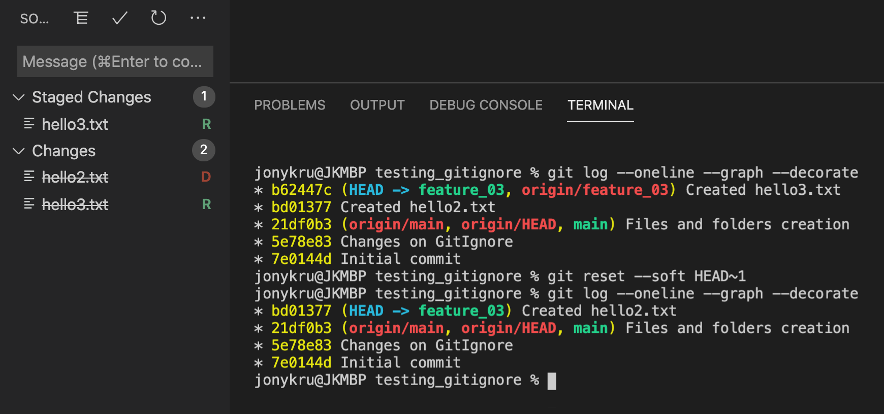
Detaching a commit: git reset --soft
Afterwards:
--soft will keep both staged and unstaged changes

Slide 37
Detaching a commit: git reset --mixed
Before

Slide 38
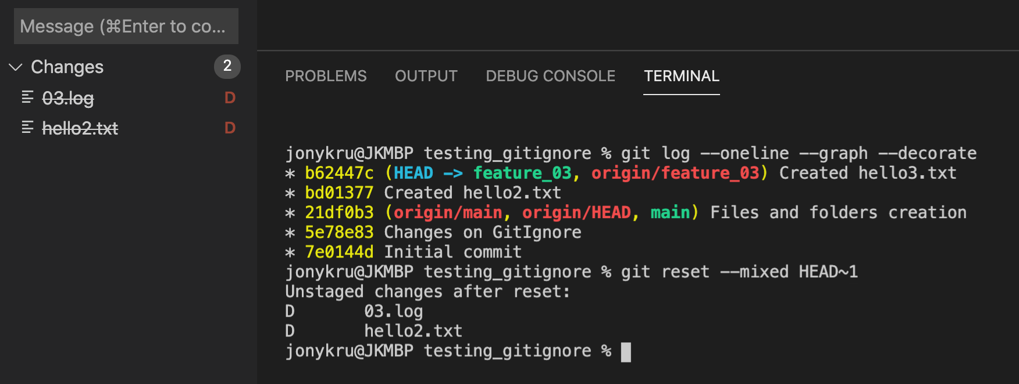
Detaching a commit: git reset --mixed
Afterwards:
--mixed discarded the staged changes

Slide 39
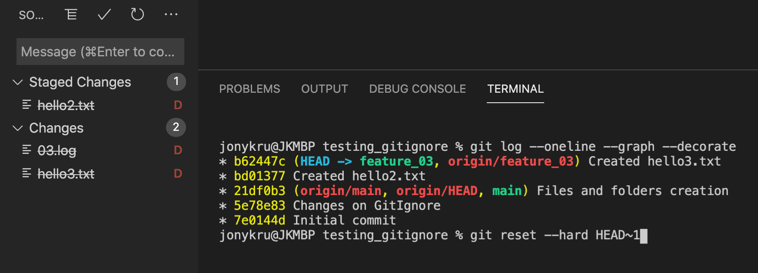
Detaching a commit: git reset --hard
Before:

Slide 40
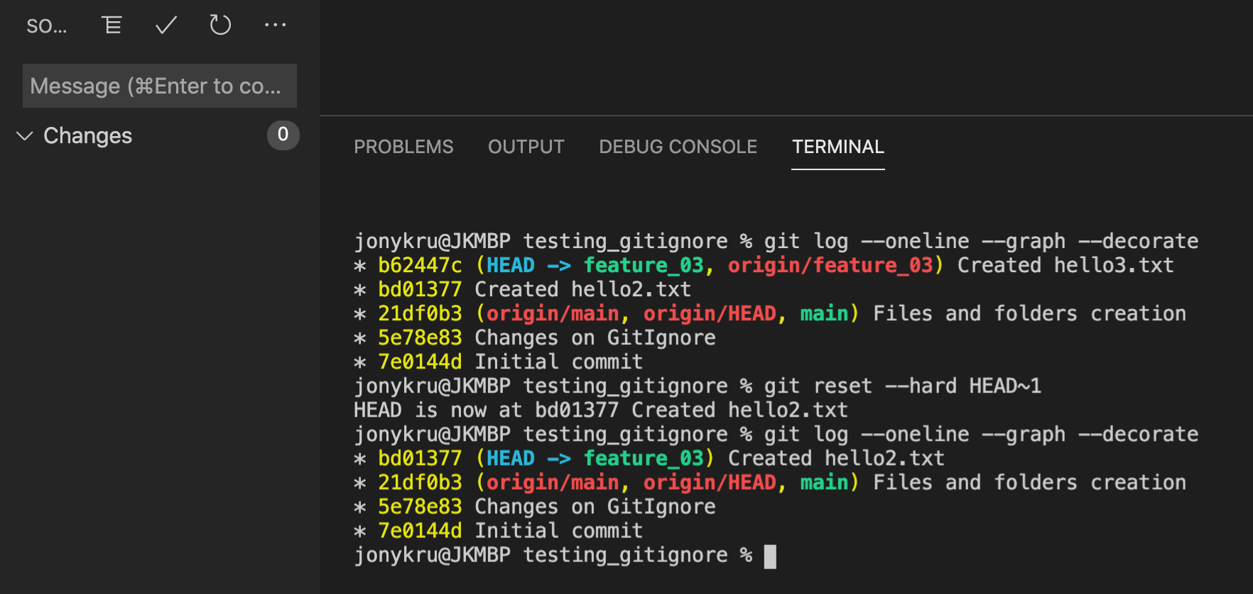
Detaching a commit: git reset --hard
After:
--soft kept both staged and modified

